Slide 1
Chongqing University of Technology
ATAI
Advanced Technique of Artificial Intelligence
Chongqing University of Technology
A Dual Reinforcement Learning Framework for Unsupervised Text Style Transfer
IJCAI 2019
https://github.com/luofuli/DualRL
Hongyang Song

Slide 2
Outline
Introduction
Method
Experiments

Slide 3
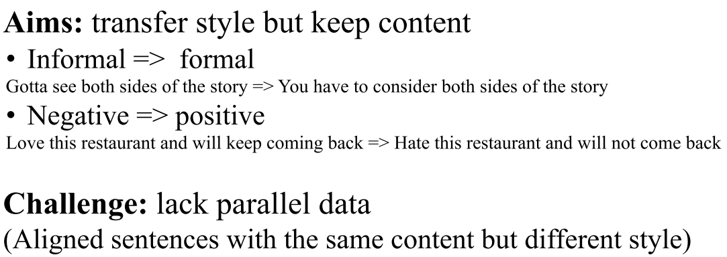
Introduction

Slide 4
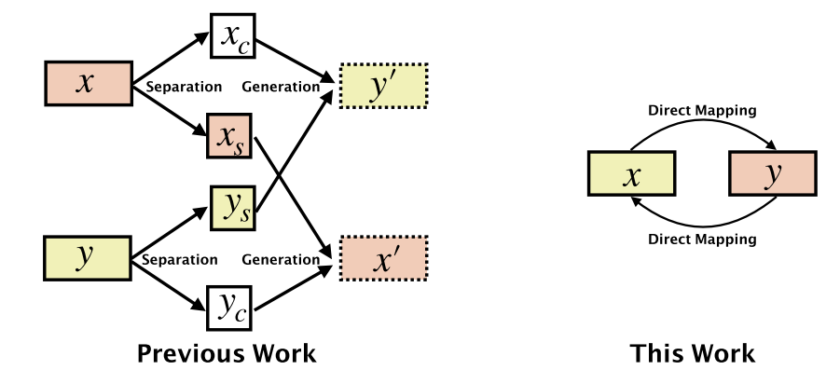
Method

Slide 5
Method

Slide 6
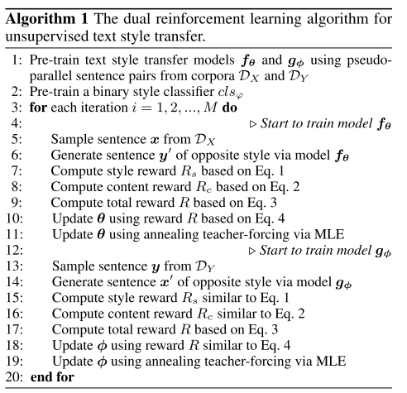
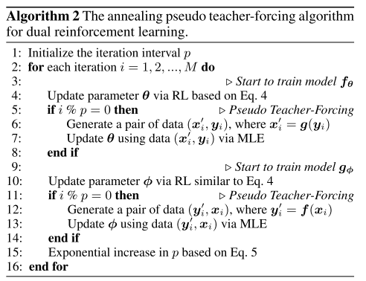
Method

Slide 7
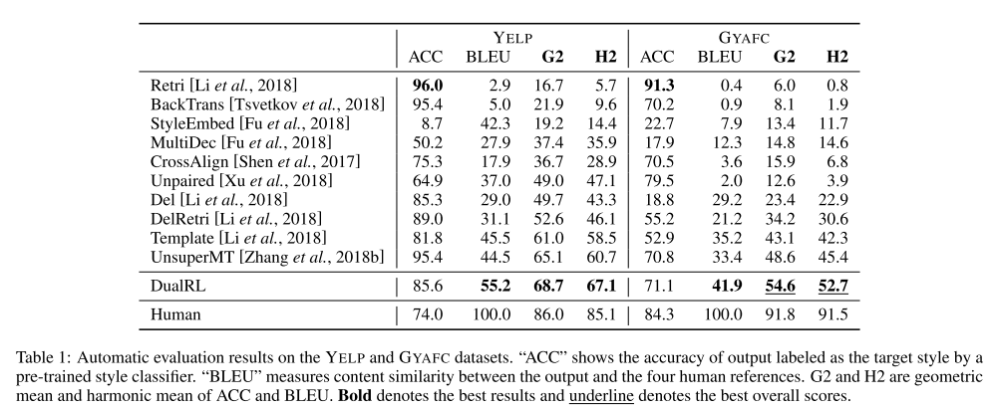
Experiments

Slide 8
Experiments

Slide 9
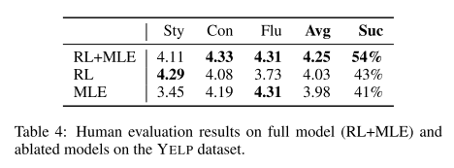
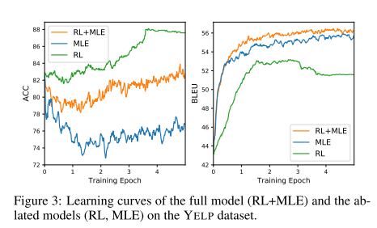
Experiments

Slide 10
Thanks

